Slide 1


Live coding session
Hexagonal Architecture From scratch
@tpierrain (use case driven)

Slide 2
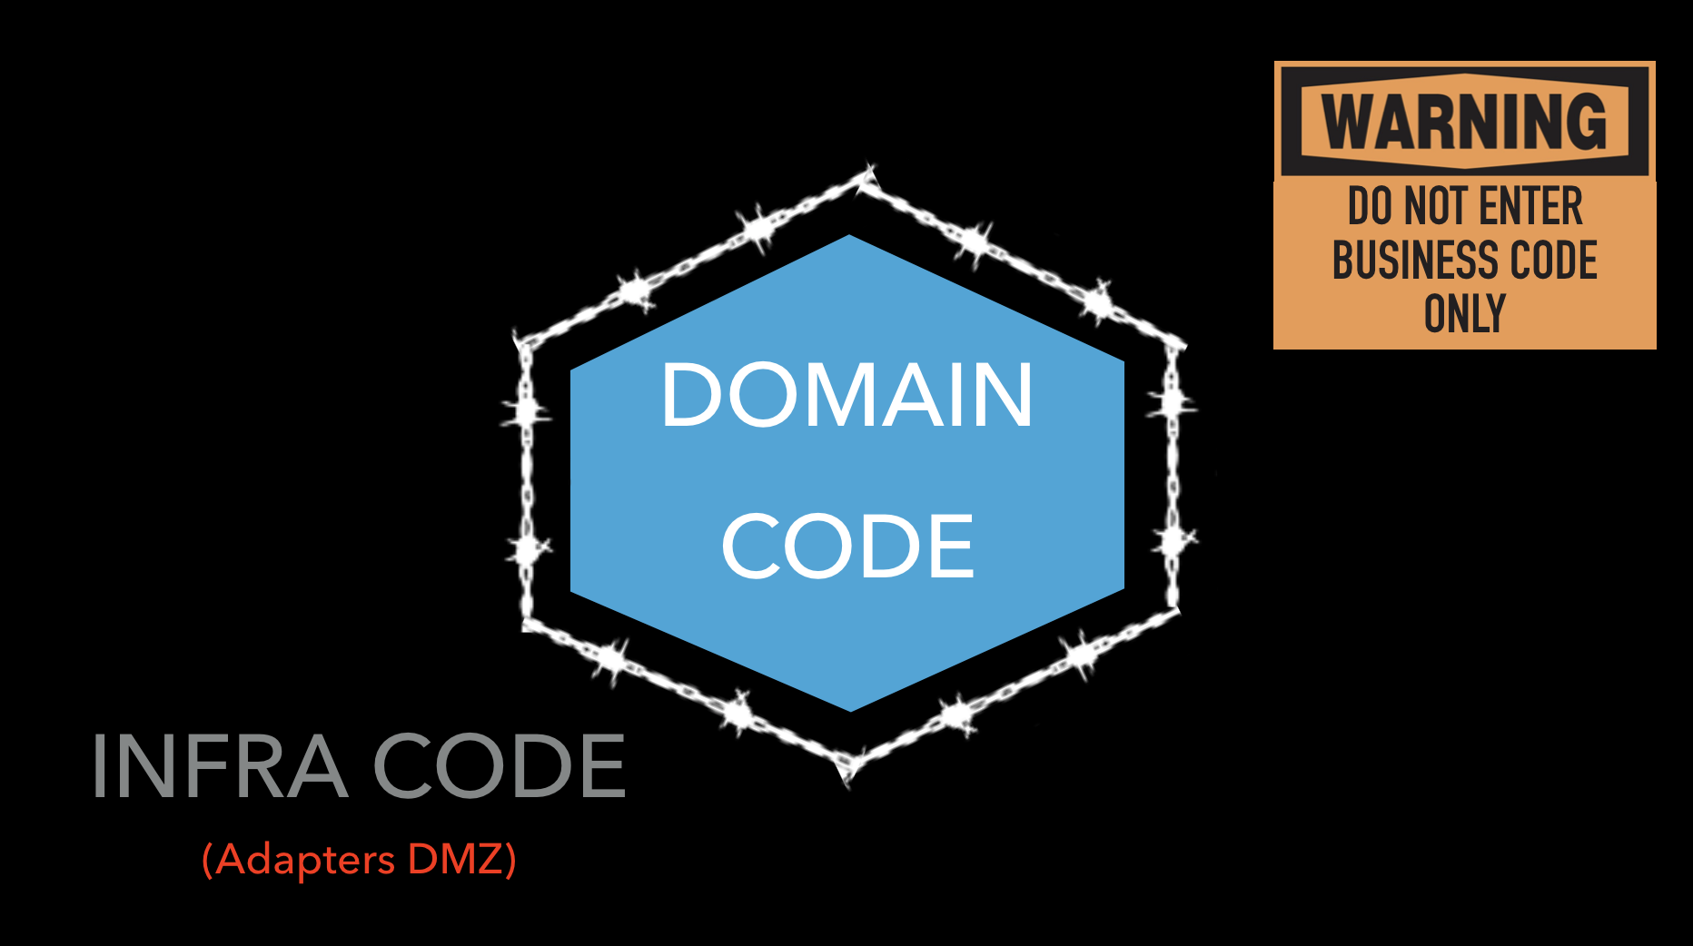
Hexagonal Architecture FTW!

Slide 3
Hexagonal Architecture?

Slide 4
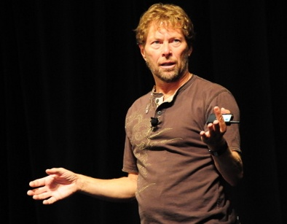
Hexagonal architecture
Alistair Cockburn

Slide 5
Many Benefits
Hexagonal Architecture
Embrace change
>> Protect your domain code <<
Enforce testability…

Slide 6
Hexagonal Architecture
How?

Slide 7
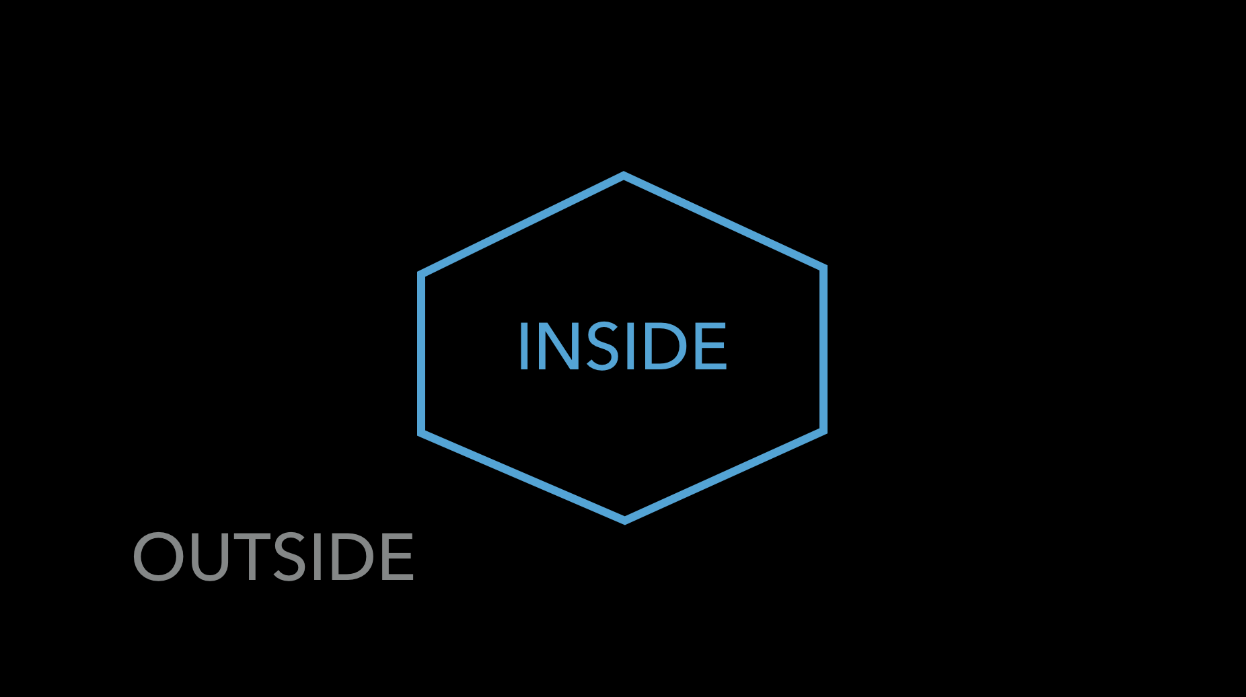
Hexagonal Architecture

Slide 8
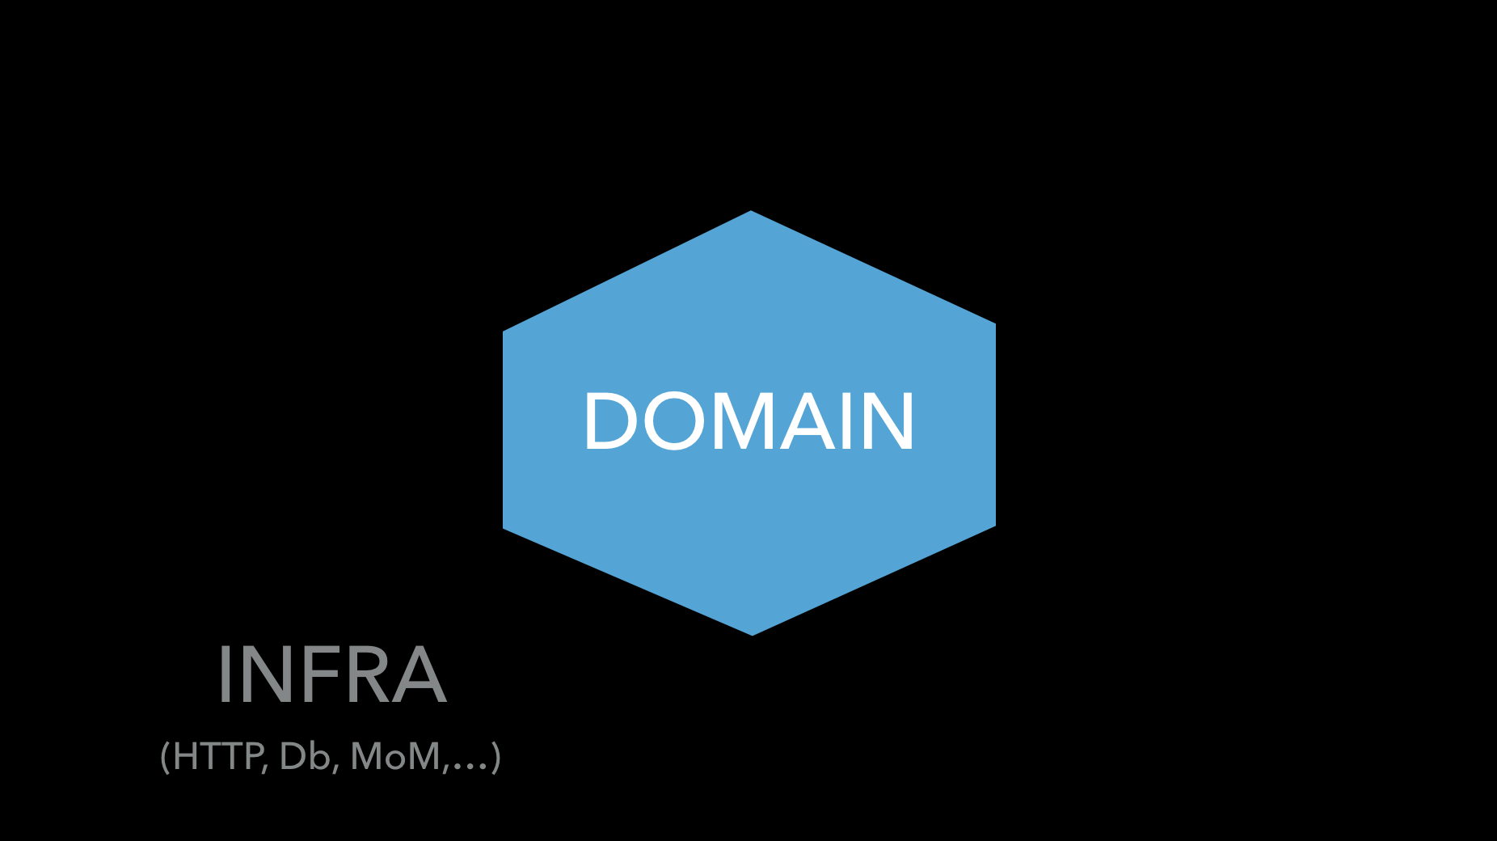
Hexagonal Architecture

Slide 9
Hexagonal Architecture

Slide 10

Hexagonal Architecture

Slide 11
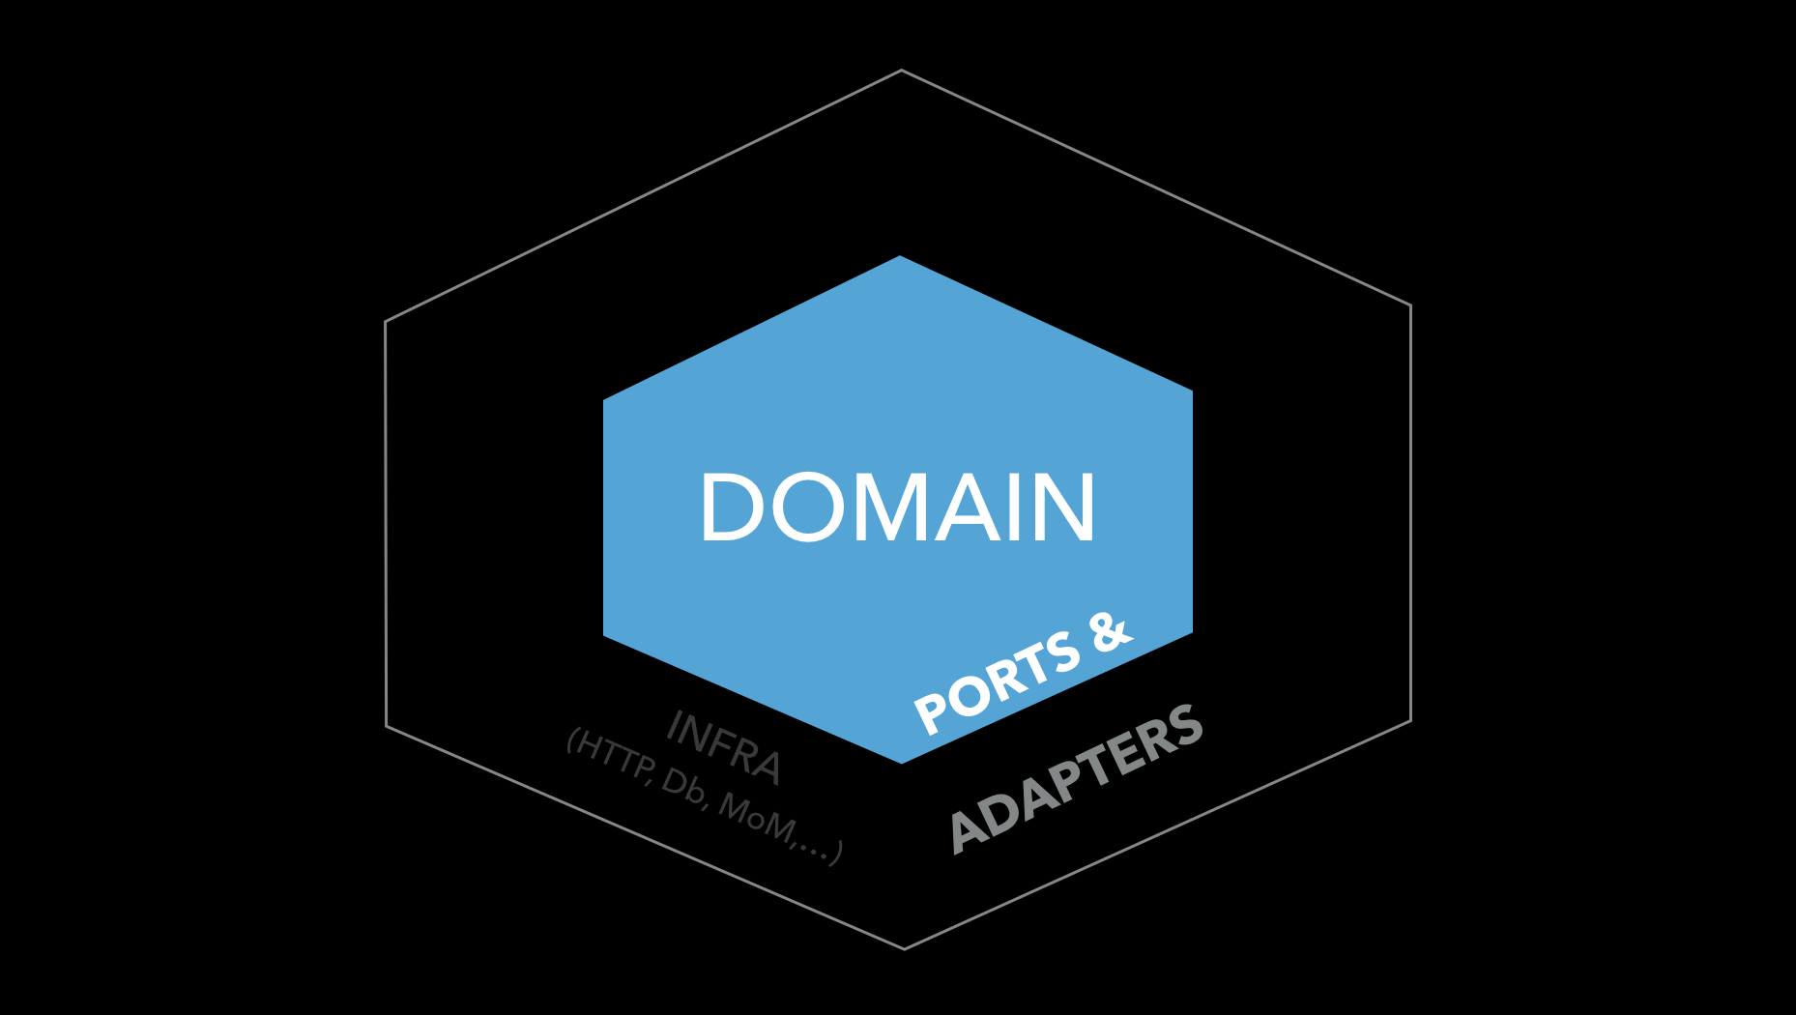
Hexagonal Architecture
Dependencies
Always
Toward
The inside
DIP principle
“Configurable dependencies”

Slide 12
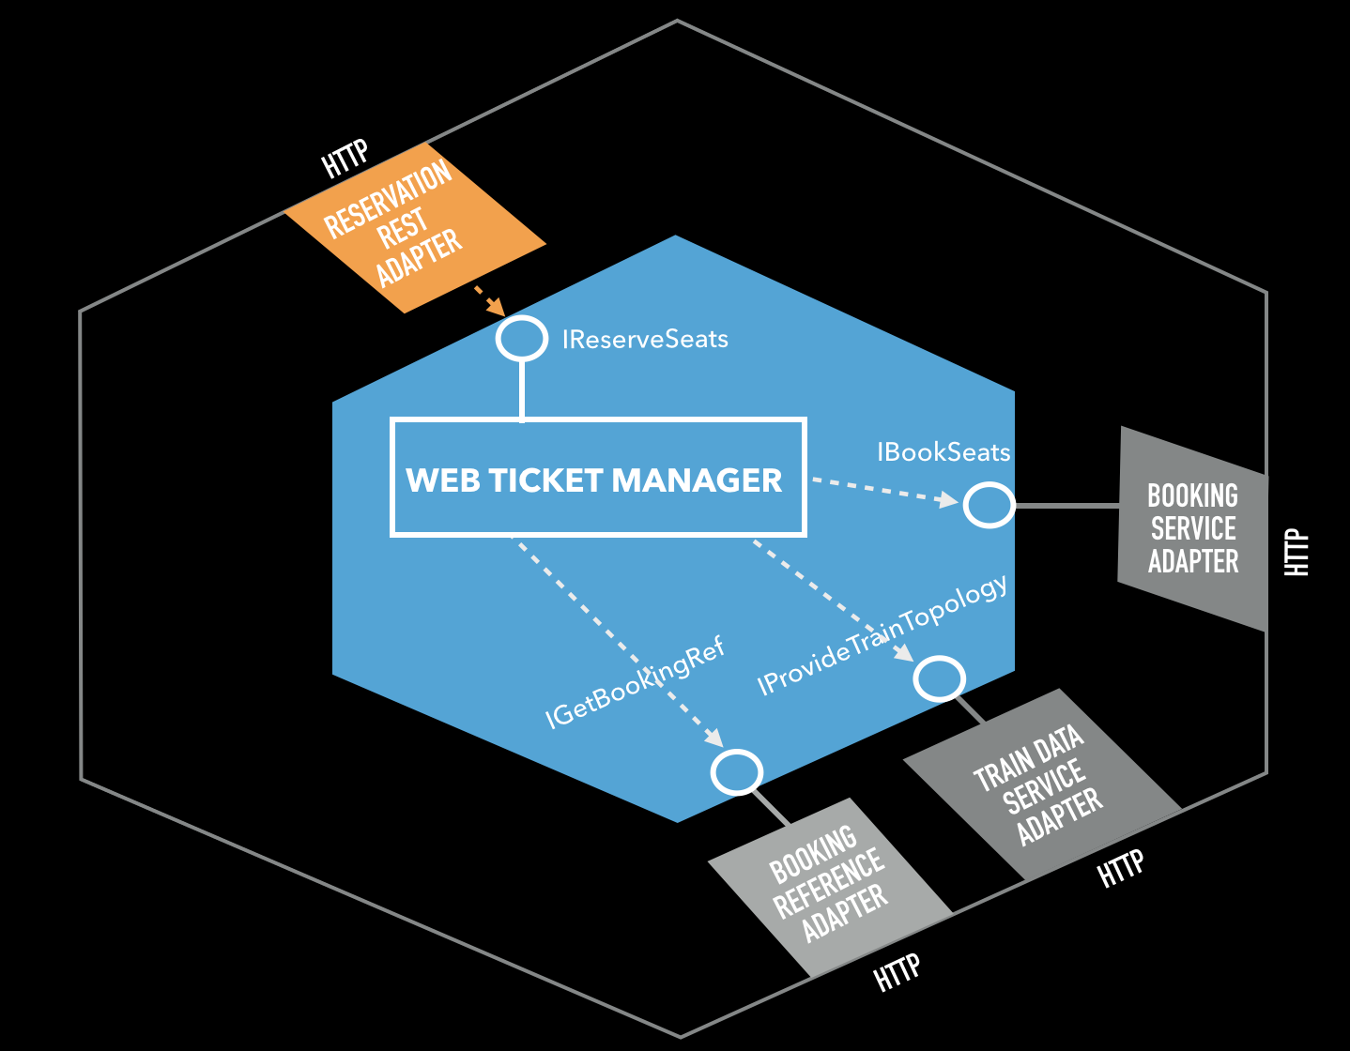
Hexagonal Architecture
Ports
IN the
domain
Adapters
IN the
Infra

Slide 13
Hexagonal Architecture
Ports And adapters
To go IN
To go Out

Slide 14
Hexagonal Architecture
A 3 steps initialization The “key ring” metaphor

Slide 15

Hexagonal Architecture
1. Instantiate the ”I need to go out” Adapters
Train Data Service Adapter
Booking Reference Service Adapter

Slide 16
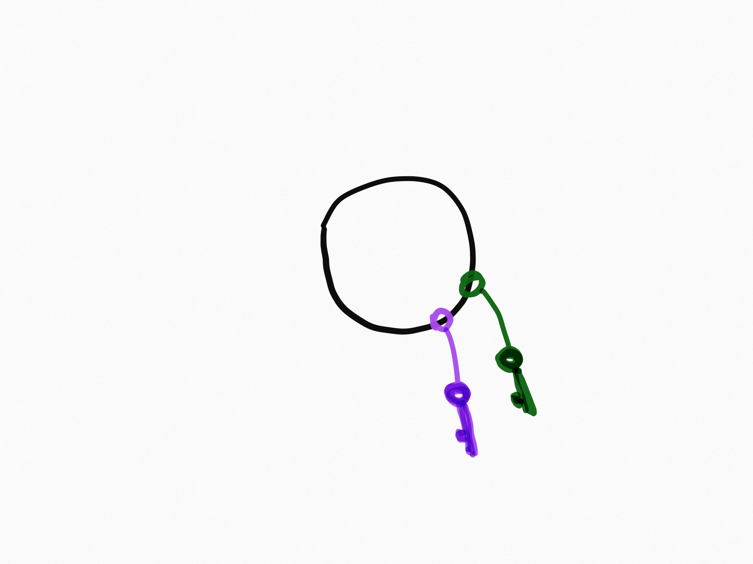
Hexagonal Architecture
2. Instantiate the Hexagon
Web Ticket Manager
Train Data Service Adapter
Booking Reference Service Adapter

Slide 17
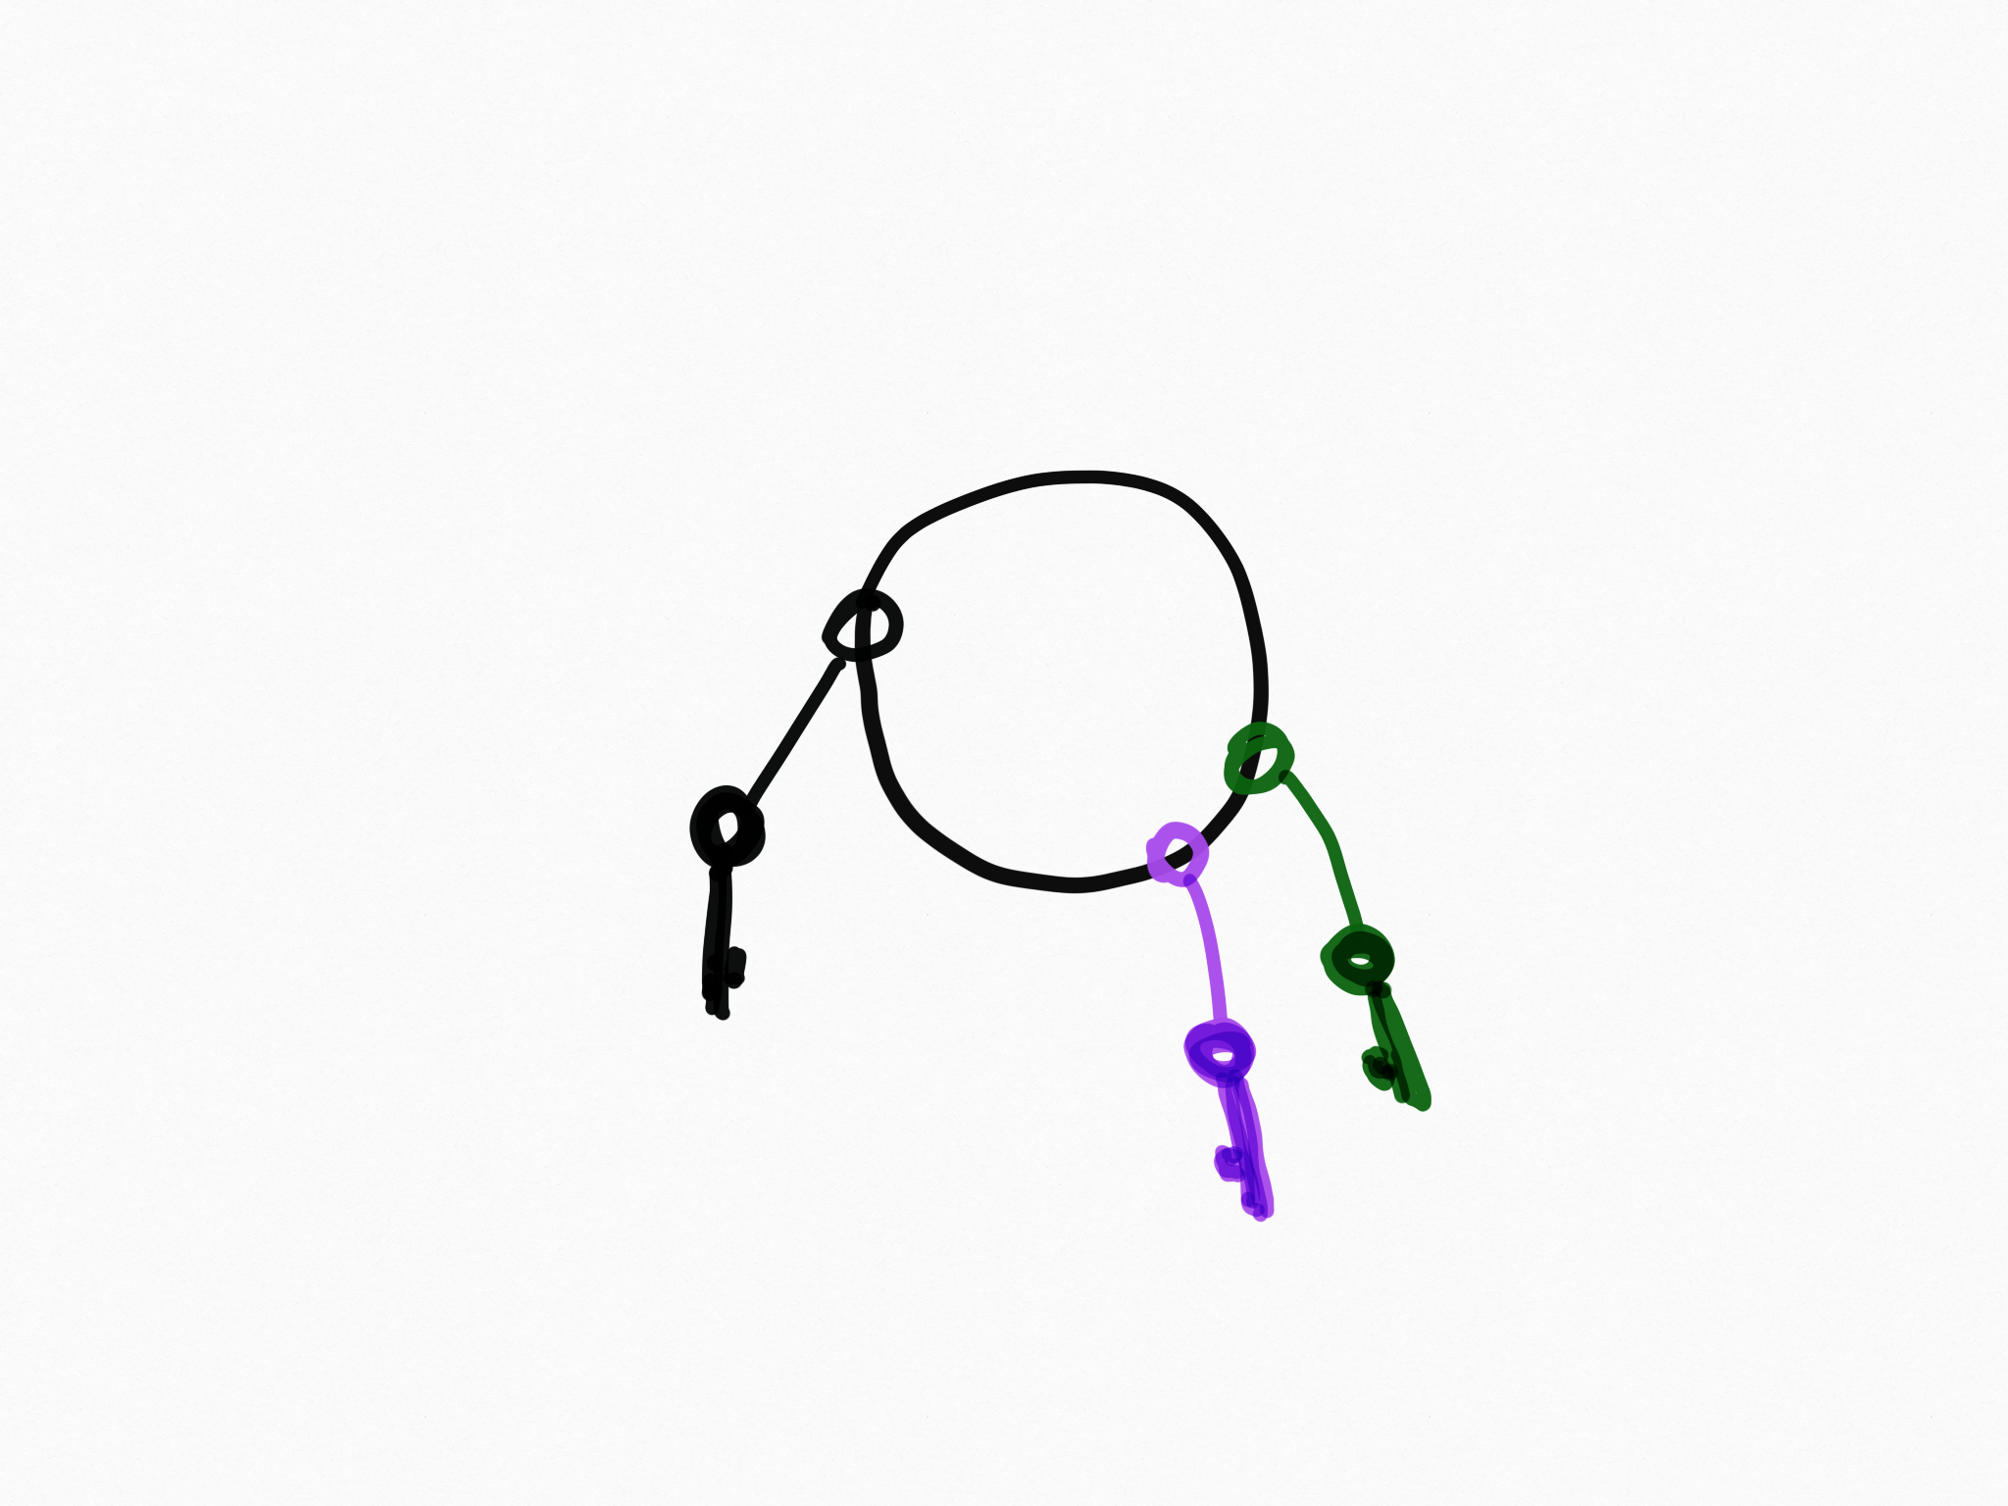
Hexagonal Architecture
3. Instantiate the ”I need to Enter” Adapters
Web Ticket Manager
Train Data Service Adapter
Reservation REST Adapter
Booking Reference Service Adapter

Slide 18
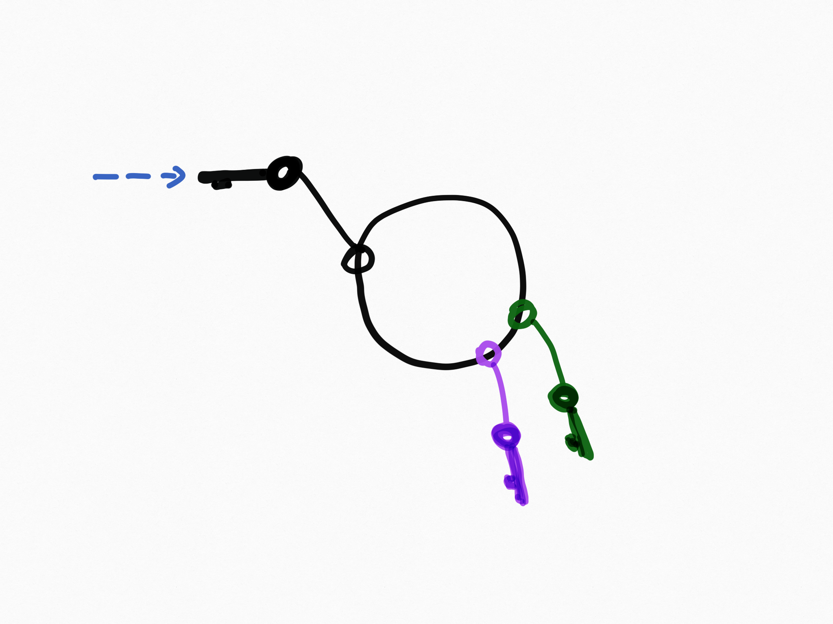
Hexagonal Architecture
All you keep in “your hand”
Reservation REST Adapter
Web Ticket Manager
Train Data Service Adapter
Booking Reference Service Adapter

Slide 19
Hexagonal Architecture
All you keep in “your hand”
Seat Reservation Adapter
Web Ticket Manager
Train Data Service Adapter
Booking Reference Service Adapter

Slide 20
Hexagonal Architecture
To Put IT differently…

Slide 21
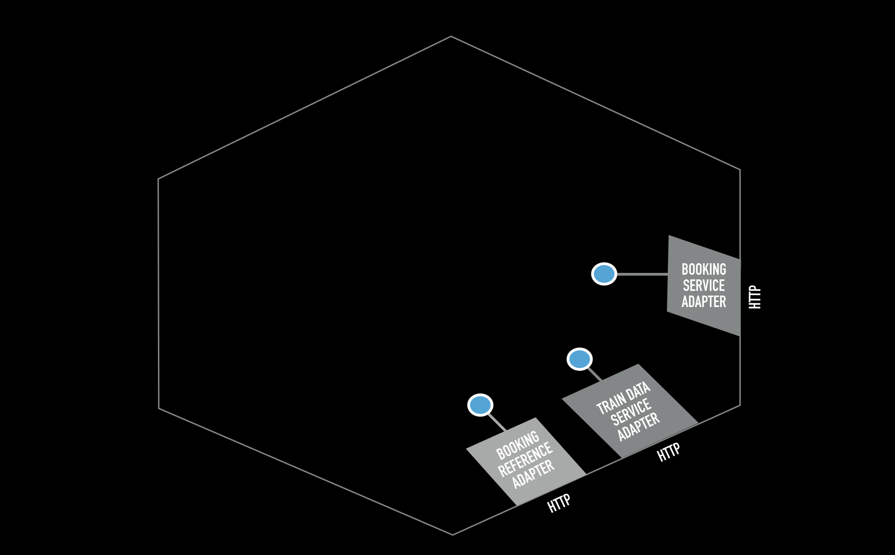
A 3 steps initialization
1. Instantiate the ”I need to go out” Adapters

Slide 22
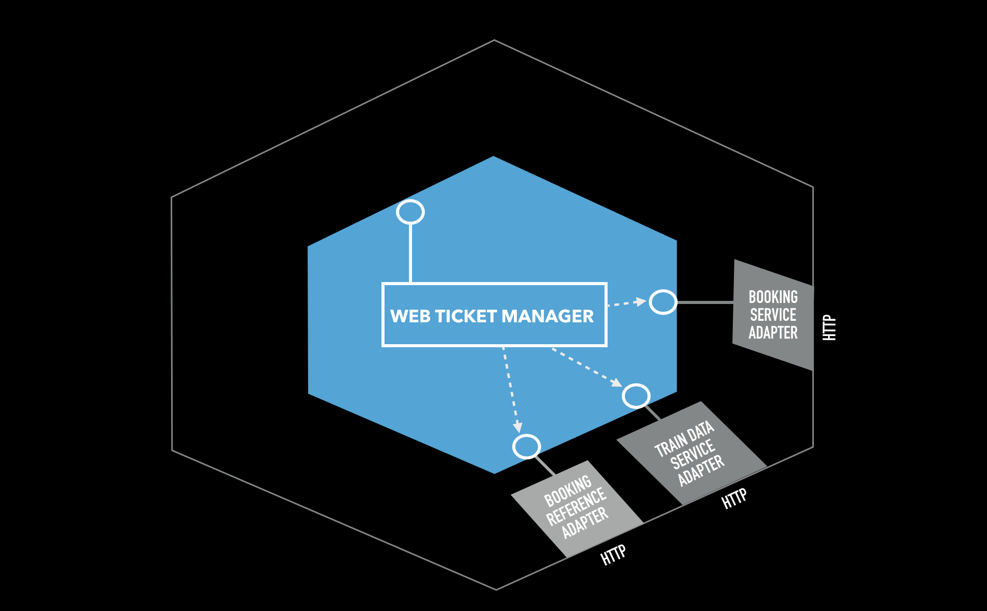
A 3 steps initialization
2. Instantiate the Hexagon

Slide 23
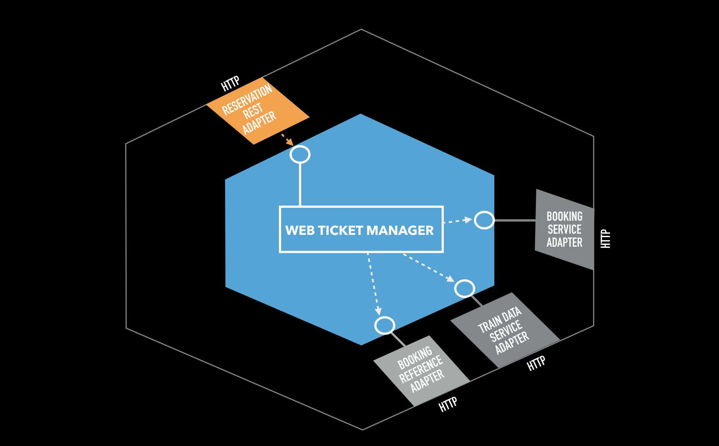
A 3 steps initialization
3. Instantiate the ”I need to Enter” Adapters

Slide 24
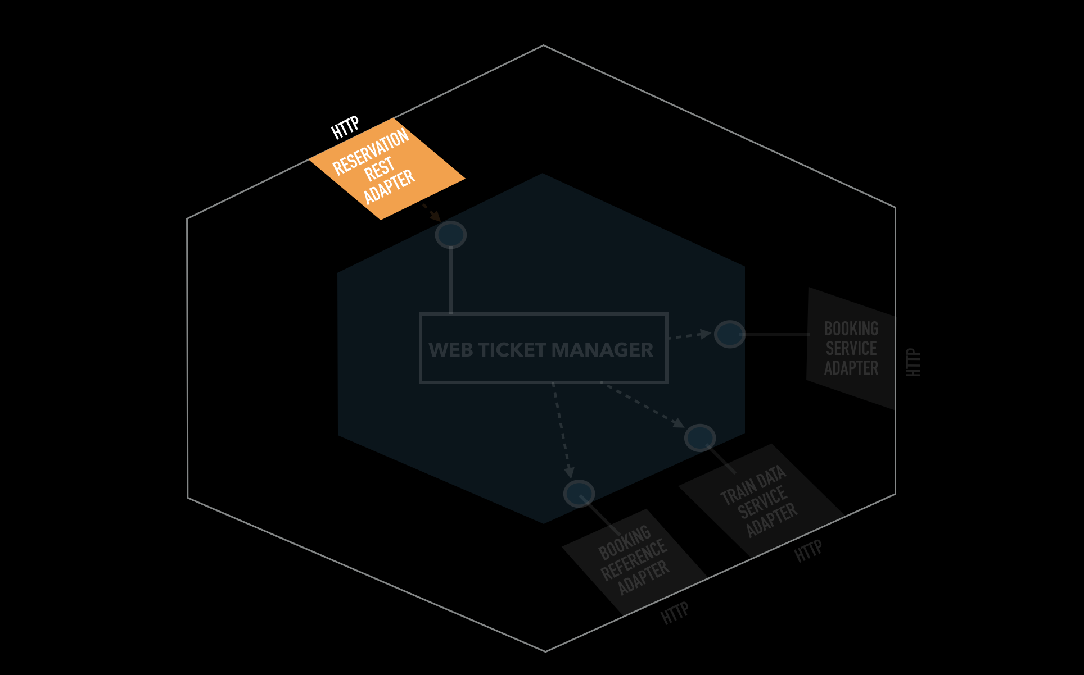
A 3 steps initialization
All you keep in “your hand”

Slide 25
Hexagonal Architecture
Our case for today…

Slide 26
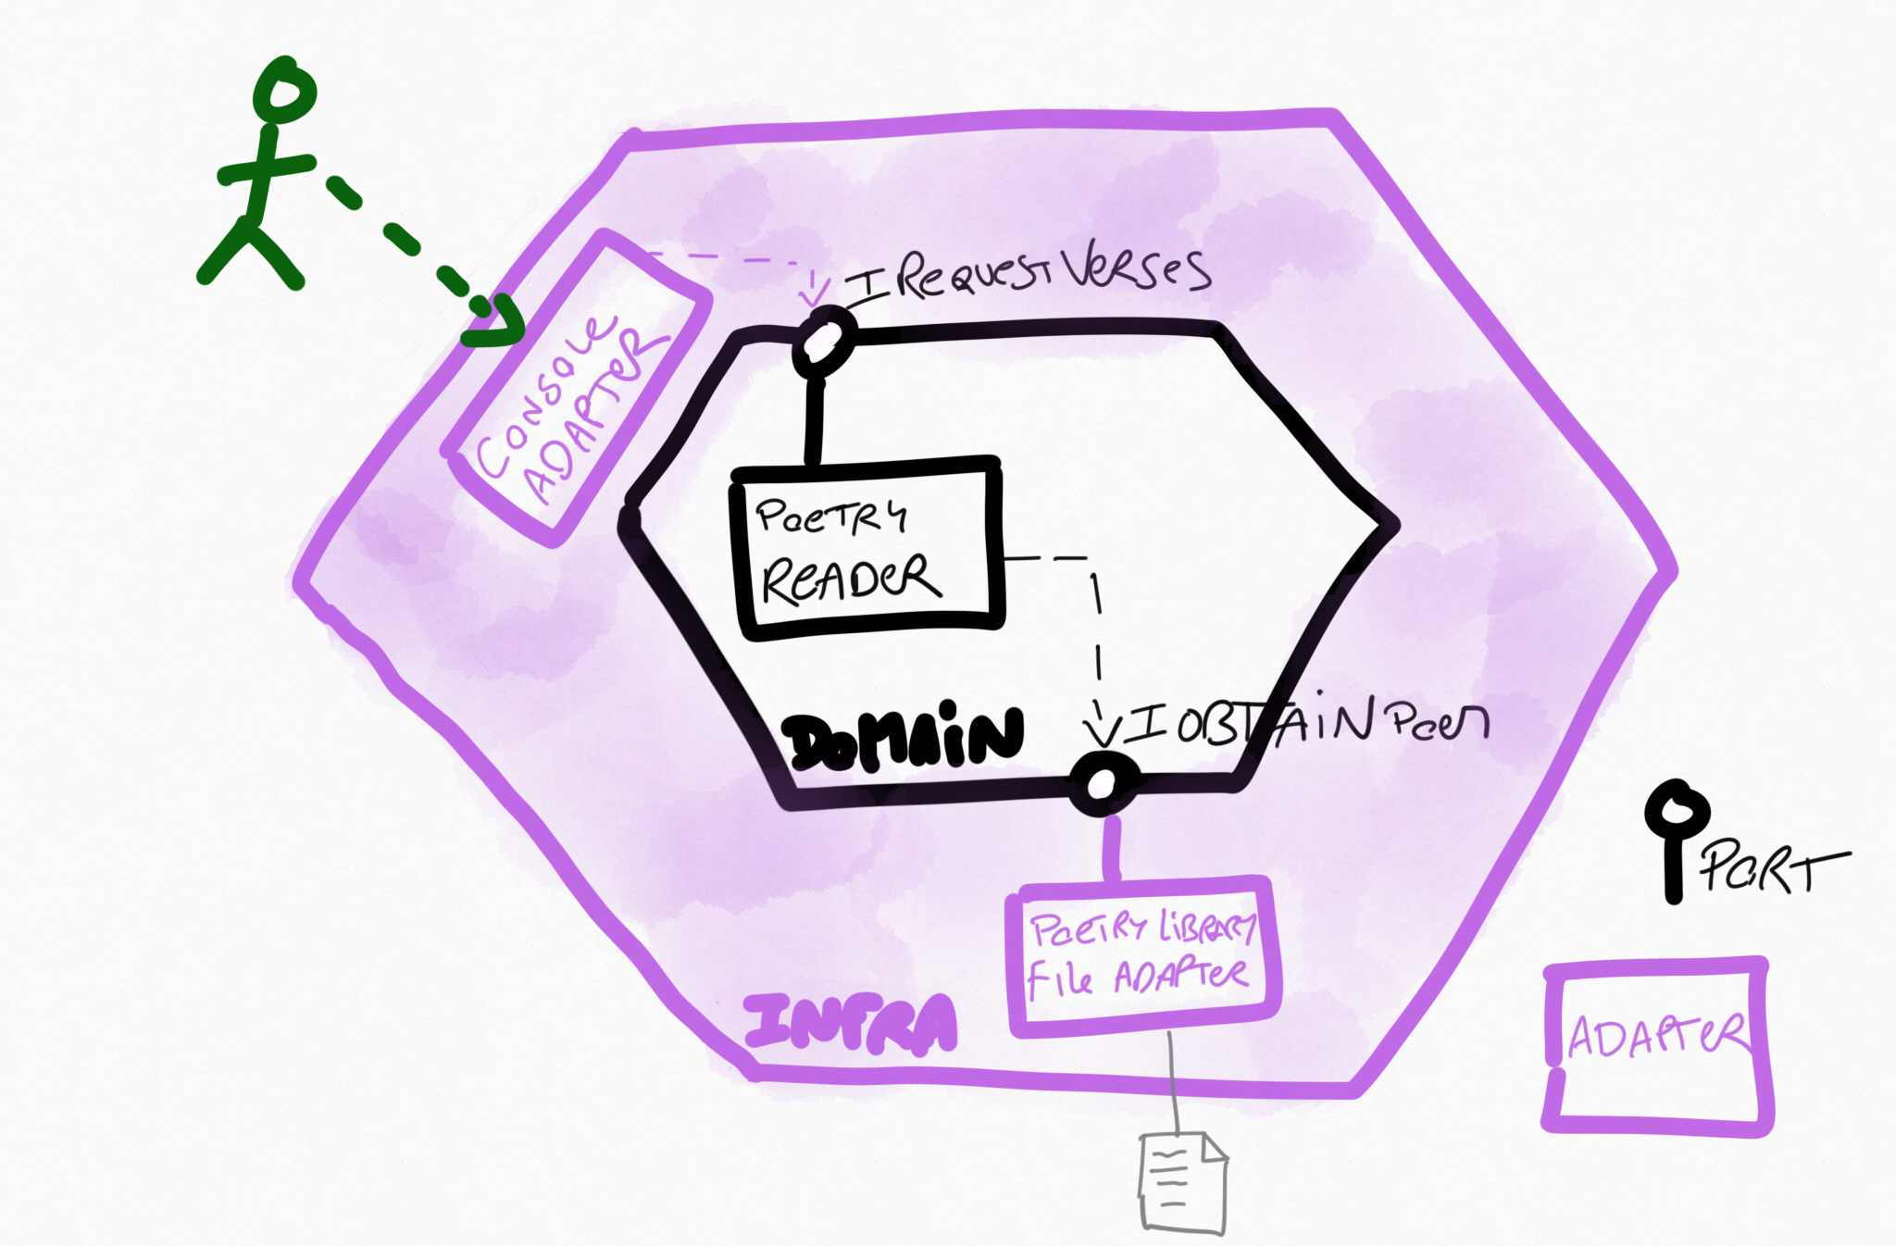
Poetry!

Slide 27
Hexagonal Architecture
Let’s do it!

Slide 28
Wrap-up

Slide 29
Wrap-up
Ease Outside-in TDD
Split Domain / Infra code
Embrace Changes
Merci ;-)

Slide 30
QUESTIONS?

